Slide 1
Year 1
Parents
Phonic
Meeting

Slide 2


What is phonics?
Sounds
Graphemes
demonstrate, containing, roamed, trivial, injured, whimper
Notes:
All words are made up of individual sounds. These sounds are blended together to form words.
e.g. in ‘mat’ we have the sounds ‘m’, ‘a’, ‘t’, ship – ‘sh’, ‘i’, ‘p’.
Click A grapheme is another name for the letters we use to write the sound. It’s spelling of a sound on the page.
Using phonics, children learn to read by saying each sound and blending them to read a word.
Children learn to spell by segmenting a word into sounds and writing the matching graphemes.
The National Curriculum ensures that all children are taught Phonics systematically.
This gives your children the tools to read any word, for example demonstrate, containing, roamed, trivial, injured, whimper.

Slide 3
English alphabetic code
44 sounds
26 letters
Over 150+ graphemes (letter combinations)
One of the most complex alphabetic codes in the world.
Notes:
We use 44 sounds to make all the words in the English language.
This means we’ve got a problem.
Click. We’ve got 44 sounds and only 26 letters.
The 26 letters work singly, in pairs and sometimes in threes to represent one sound.
We have to group letters together to write some sounds e.g. ‘igh’, ‘air’.
In English we have more than 150 ways to represent 44 sounds, using the 26 letters in the alphabet.
Click. This makes our language one of the most complex in the world!

Slide 4
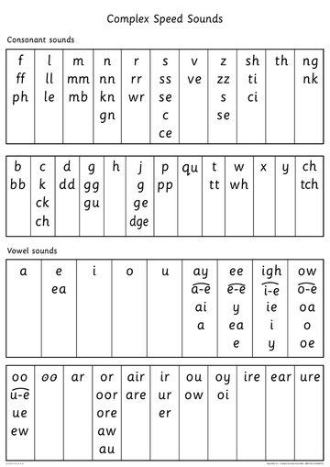
Complex Speed Sounds

Slide 5
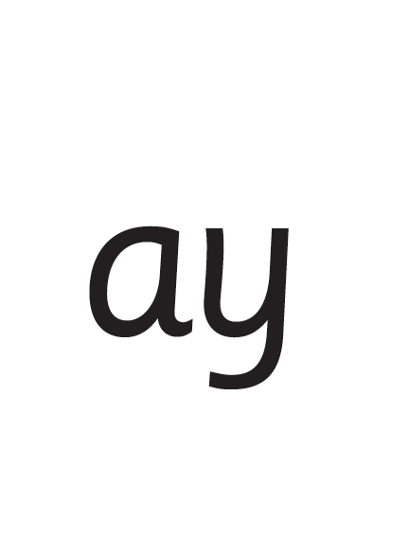
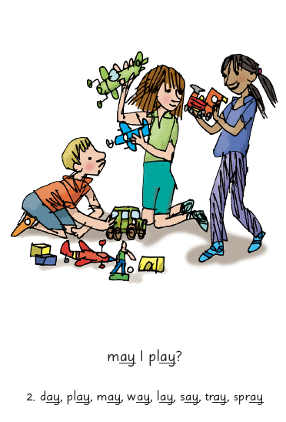

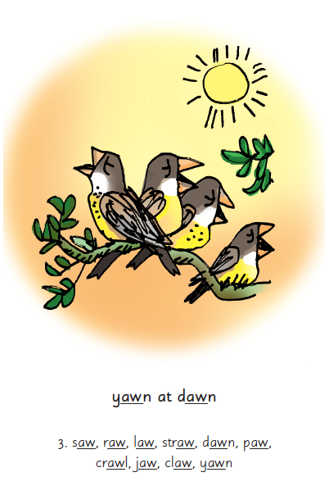
Picture Phrases
Notes:
We use a brief story and a picture phrase to help children to remember the Set 2 and Set 3 sounds.
For example, ay, may I play? aw, yawn at dawn.
We teach children to read and write three new Set 2 or 3 sounds each week.
We review the sounds we’ve taught before until they can read them speedily.

Slide 6
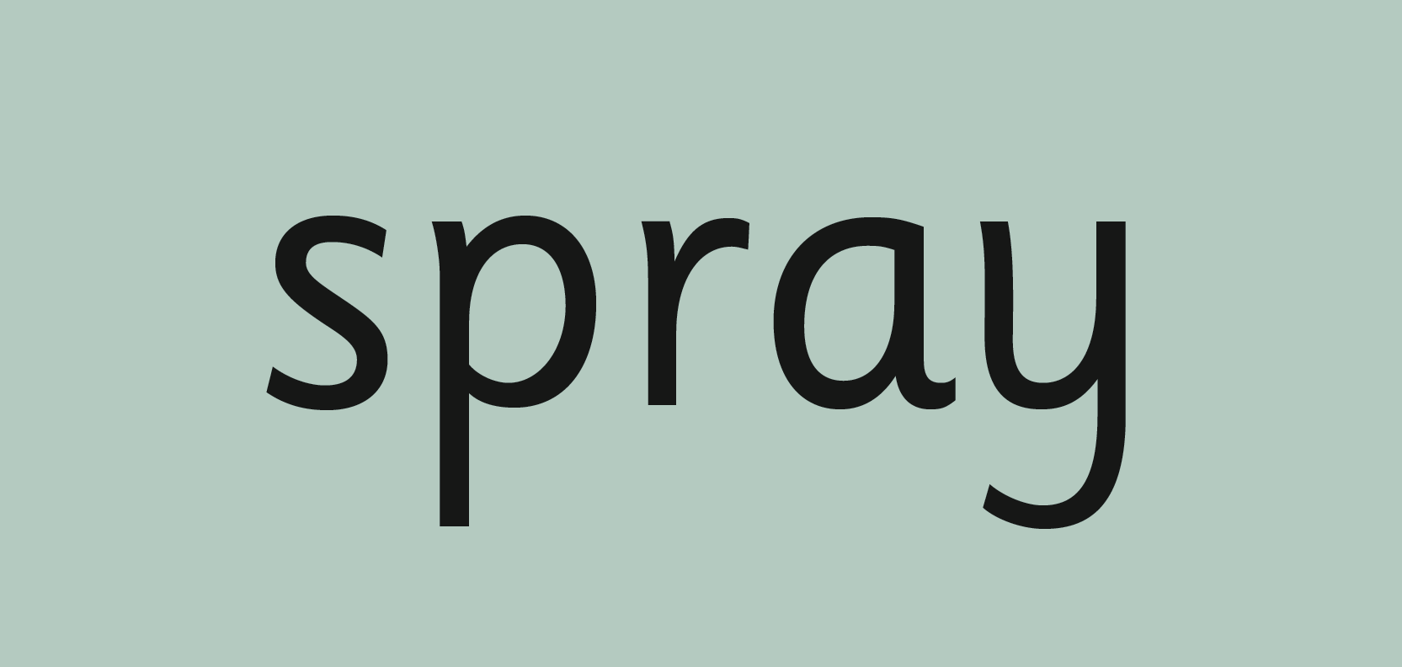

‘Special Friends’, ‘Fred Talk’
Notes:
Each day, children practise reading the sounds they know in words.
We use the routine ‘Special Friends’, ‘Fred Talk’.
They spot the ‘Special Friends’ first, then Fred Talk to read the word.
For example, ‘ay’, s-p-r-ay, spray.

Slide 7
Phonic Screening Check
I want to help you understand more about the Phonics Screening Check – a word reading test that all Year 1s undertake in June.
This year’s test will take place in the week commencing Monday 9th June.
Accurate word-reading at six is a good predictor of future reading success.

Slide 8
What is the Phonics Screening Check?
A word-reading test at the end of Year 1
• Children read 40 words
• The test is not timed and children will read to an adult that they know (usually their class teacher)
• The pass mark is currently 32 words. If children do not meet this standard, they will continue to receive extra support and will retake the test in Year 2.

Slide 9
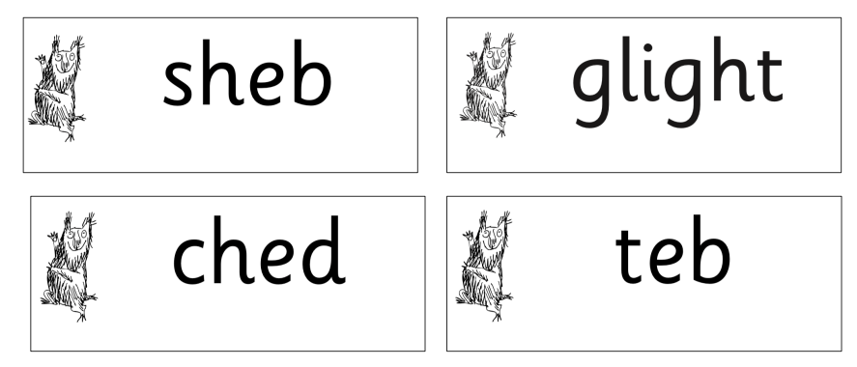
Nonsense words
Half of the words in the check are real words. Half the words are alien words.
There is a picture of an alien next to each word to remind the children that it isn’t a real word.

Slide 10
What can you do?
Use ‘Special Friends’, ‘Fred Talk’, read the word’ to read words
Practise reading sounds speedily - ‘review, review, review’
Listen to your child read their Storybook every day
Notes:
Practise the sounds and phrases.
Practise reading sounds speedily.
Help your child use ‘Special Friends’, ‘Fred Talk’ to read words
Watch the Virtual Classroom films together.

Slide 11
Online resources available
Ruth Miskin Parents’ Page:
https://www.ruthmiskin.com/parents/
Ruth Miskin Facebook:
https://www.facebook.com/miskin.education
Free e-books for home reading:
http://www.oxfordowl.co.uk/Reading/

Slide 12
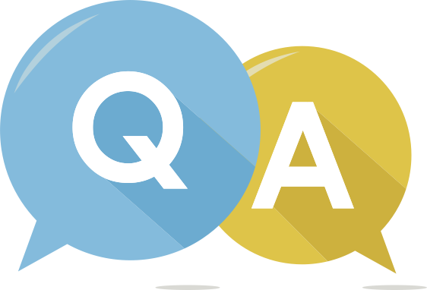
Any questions?

