Slide 1
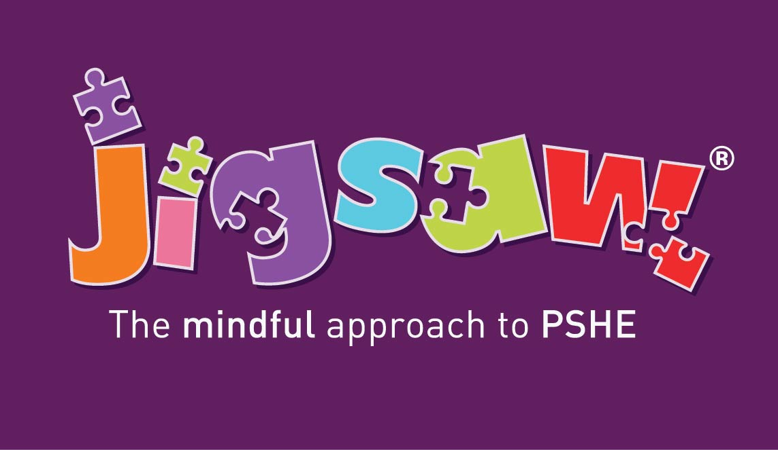
Consultation and Parental Engagement for RHSE
(Relationships, Sex AND Health Education)
How do we meet the statutory guidance in and make it meaningful for our school community?
Notes:
© 2021 Jigsaw PSHE Ltd
DO NOT REPUPLISH THIS POWERPOINT PRESENTATION
Due to copyrighted, licensed and trademarked content.
This presentation is intended and licensed for use internally for staff training purposes only.

Slide 2
This presentation outlines:
What the statutory expectations are for consultation and parental engagement on RSHE
Why this is important to your school community
How you can consult in a way that is meaningful for all
Where you can find additional support and information
Notes:
Replace the date and time of your webinar

Slide 3
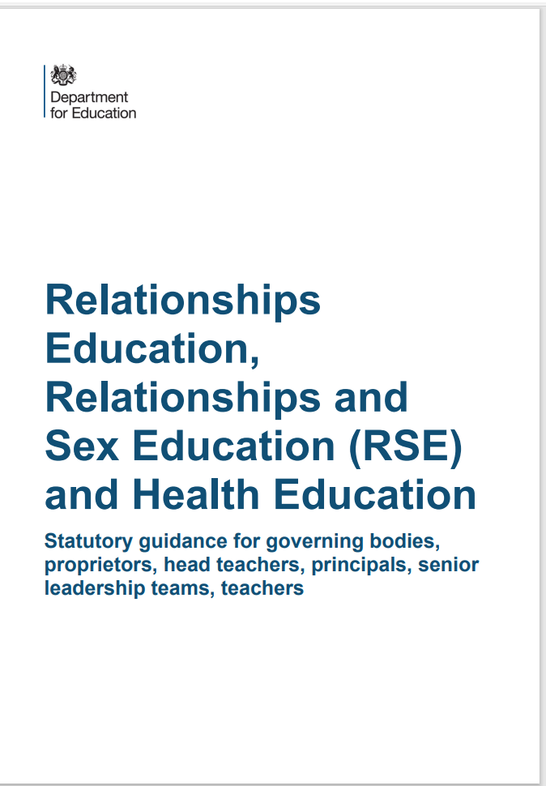
What do we have to consult on?
The DfE’s 2019 RSHE and RSE Guidance states in paragraph 13:
“All schools must have in place a written policy for Relationships Education and RSE. Schools must consult parents in developing and reviewing their policy. Schools should ensure that the policy meets the needs of pupils and parents and reflects the community they serve.”

Slide 4
We don’t do this for other subjects. Why RSE?
Confidence
Staff, governors and parents need to feel comfortable talking about any issues that come up, and the context in which we are discussing them
Shared Responsibility
Children learn about Relationships and other topics in PSHE at home. We need to build in opportunities throughout the academic year for parents to be informed about the topics we cover in class – consultation can help us find out the best ways to do this. Parents can then prepare their child when they feel they need to and support them with any further questions beyond the lesson itself.
Sensitive Subjects
The topics we discuss in RSE – and PSHE – can sometimes be sensitive. Consultation enables us to carefully consider different views and seek consensus.
Mutual Respect
We need to listen to and respect the views of our parents and carers in the same way as we respect the views of their children in our classrooms and demonstrate how we encourage our pupils to do the same.
Reassurance
We need to explain what we are actually teaching in school, and what we are not teaching. The myths and misinformation in the media are leading to very real parental fear which we can dispel early BEFORE we teach these topics.

Slide 5
Where you can find our policy and additional information…
An updated copy of the RSE policy is available on the website for you to read through at your convenience.
We have also linked a copy to the DfE’s Statutory Guidance on the website in Curriculum and in PSHE.

Slide 6
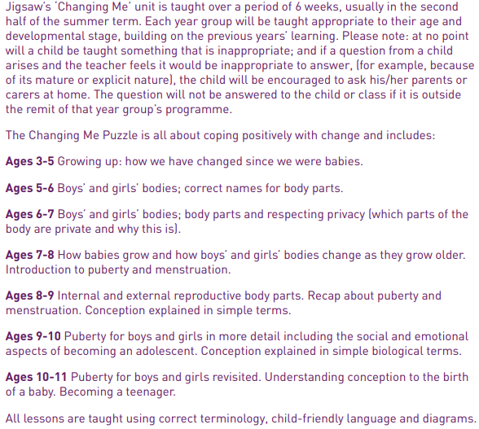
What will my child be taught about puberty and human reproduction? Progression from Early Years to Year 6.

Slide 7
Puberty and Human Reproduction in Jigsaw 3-11 Changing Me Puzzle
FS | Growing Up | How we have changed since we were babies
Y1 | My changing body | Understanding that growing and changing is natural and happens to everybody at different rates
 | Boys’ and girls’ bodies | Appreciating the parts of the body that make us different and using the correct names for them
Y2 | The changing me | Where am I on the journey from young to old, and what changes can I be proud of?
 | Boys and girls | Differences between boys and girls – how do we feel about them? Which parts of me are private?
Y3 | Outside body changes | How our bodies need to change so they can make babies when we grow up – outside changes and how we feel about them
 | Inside body changes | How our bodies need to change so they can make babies when we grow up – inside changes and how we feel about them (animations used – shorter version Female and Male Reproductive Systems)
Notes:
ALL THIS FALLS WITHIN THE STATUTORY HEALTH EDUCATION GUIDANCE…changing adolescent body so is compulsory.
More detail about exactly what is covered in each year group.
Emphasise that only 2 or 3 lessons in every year group are specifically about either puberty (statutory) or How babies are made (not statutory).
Also emphasise that correct terminology is introduced early so the school can meet its safeguarding obligations and to get the children used to using the words appropriately (ie we also teach them when it’s appropriate to use these words and when not). A further rationale for this is that in KS2, body part words are not seen as something rude or dirty.
Puberty is introduced very gently in Y3 because some girls may start their periods early and it is necessary to prepare them for this so they aren’t scared or worried.

Slide 8
Puberty and Human Reproduction in Jigsaw 3-11 Changing Me Puzzle
Y4 | Having a baby | The choice to have a baby, the parts of men and women that make babies and – in simple terms – how this happens (animations used – the Female Reproductive System)
 | Girls and puberty | How a girl’s body changes so that she can have a baby when she’s an adult – including menstruation (animations used – the Female Reproductive System)
Y5 | Puberty for girls | Physical changes and feelings about them – importance of looking after yourself (animations used – the Female Reproductive System)
 | Puberty for boys | Developing understanding of changes for both sexes – reassurance and exploring feelings (animations used – the Male Reproductive System)
 | Conception | Understanding the place of sexual intercourse in a relationship and how it can lead to conception and the wonder of a new life (animations used – the Female and Male Reproductive Systems)
Y6 | Puberty | Consolidating understanding of physical and emotional changes and how they affect us (animations used – the Female and Male Reproductive Systems)
 | Girl talk / boy talk | A chance to ask questions and reflect (single sex) (animations used – the Female and Male Reproductive Systems)
 | Conception to birth | The story of pregnancy and birth (animations used – the Female and Male Reproductive Systems)
Notes:
Notes:
Conception is introduced age appropriately in Y4 in the context of why our bodies change during puberty.
THERE IS AN ALTERNATIVE LESSON AVAILABLE IN YEAR 4 FOR SCHOOLS WHO DO NOT WISH TO TEACH THIS IN YEAR 4. If you decide not to teach conception in year 4, remember to change this slide!
Note that one lesson in Y4 is called Puberty for girls, this doesn’t exclude the boys, it covers them too, but the main focus is on menstruation.
Conception and puberty is built upon in Year 5 and then puberty, conception and childbirth is covered in more detail (but still age-appropriately) in Y6 with a chance for single gender group lessons (up until this point lesson shave all been mixed gender).
Remind the parents/carers that when moving to secondary school Sex Ed is compulsory so there is an expectation that children will be moving into Y7 with some knowledge.
The lessons that are highlighted are the only lessons that can be opted out of. In year 3 ALL LESSONS ARE MANDATORY

Slide 9
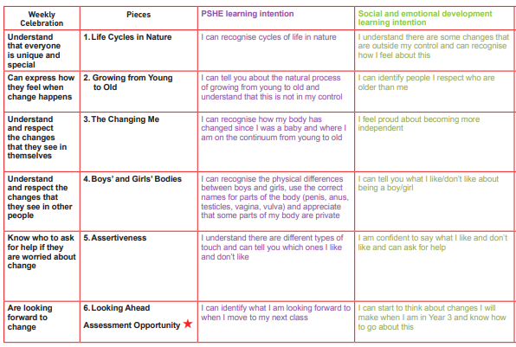
Year 2 Weekly Plan

Slide 10
Piece 1 – Life Cycles
Please teach me to…
recognise cycles of life in nature
understand there are some changes that are outside my control and to recognise how I feel about this

Slide 11
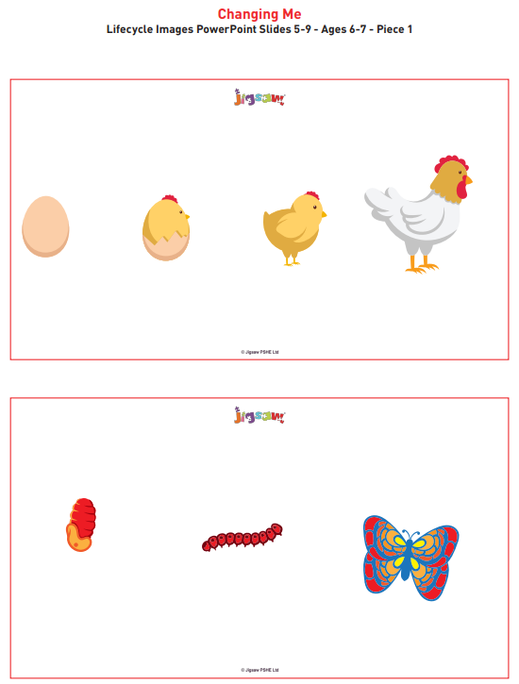
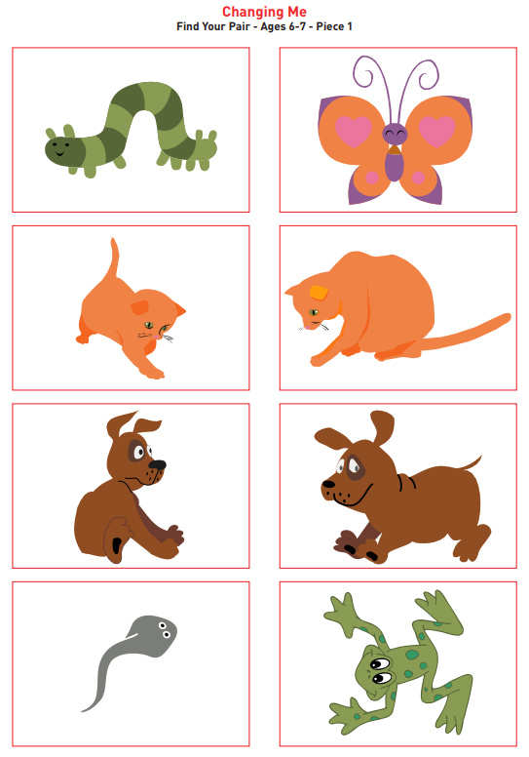
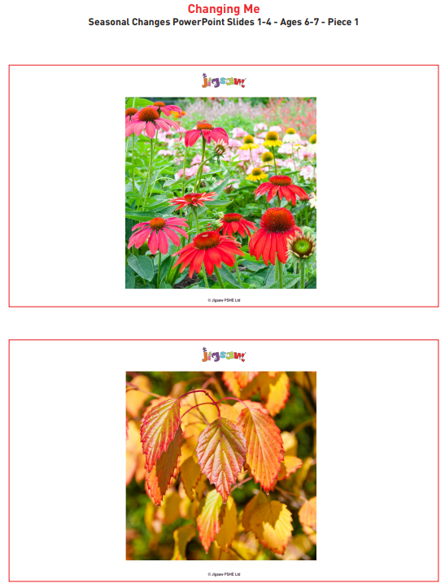
Piece 1 - Images

Slide 12
Piece 2 – Changing Me
Please teach me to…
tell you about the natural process of growing from young to old and understand that this is not in my control
identify people I respect who are older than me

Slide 13
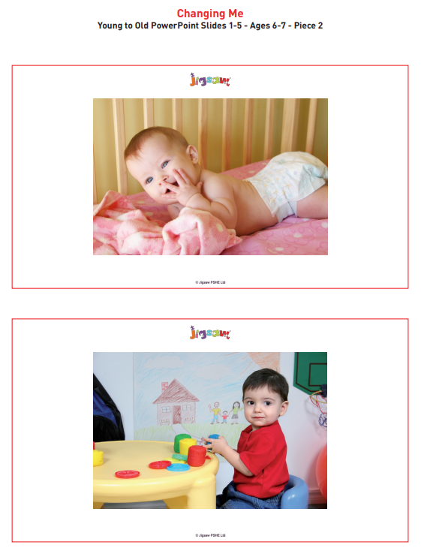
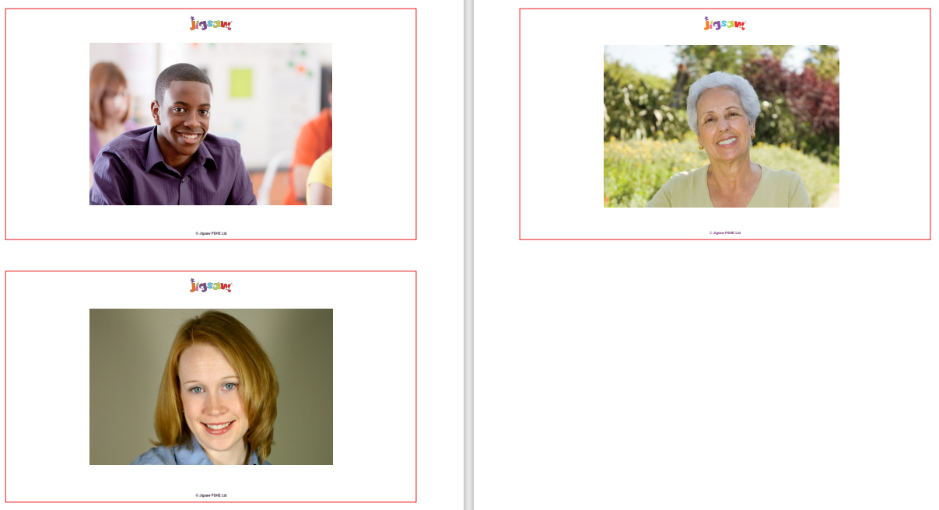
Piece 2 - Images

Slide 14
Piece 3 – My Changing Body
Please teach me to…
recognise how my body has changed since I was a baby and where I am on the continuum from young to old
feel proud about becoming more independent

Slide 15
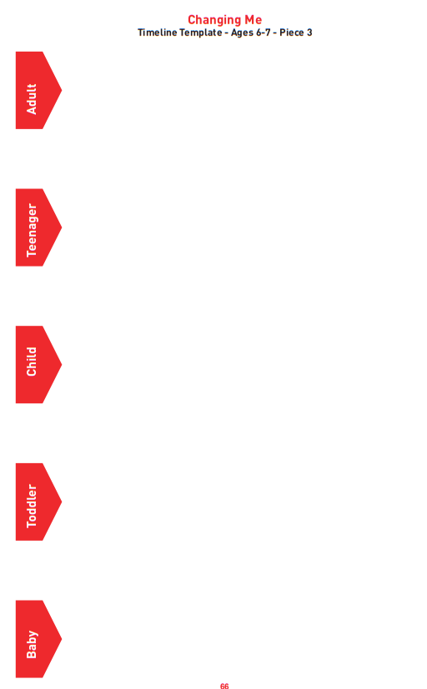
Piece 3 - Image

Slide 16
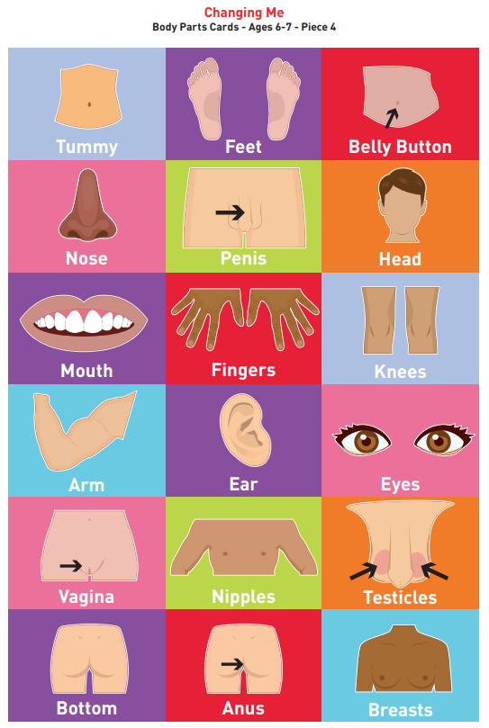
Piece 4 – Boys’ and Girls’ Bodies
Please teach me to…
recognise the physical differences between boys and girls
use the correct names for parts of the body (penis, testicles, vagina, vulva, anus) and appreciate that some parts of my body are private
tell you what I like/don’t like about being a boy/girl

Slide 17
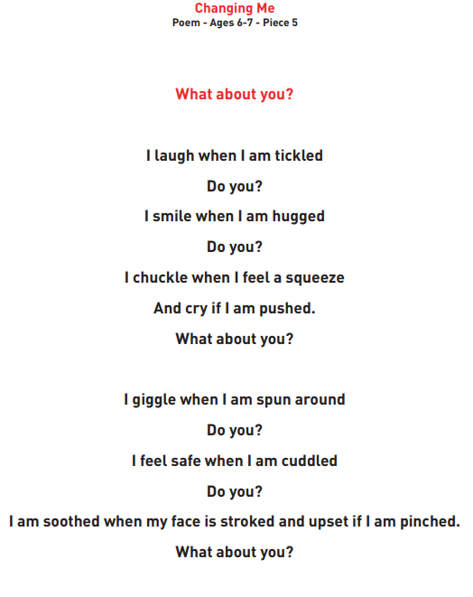
Piece 5 – Learning and Growing.
Please teach me to…
understand there are different types of touch and tell you which ones I like and don’t like
be confident to say what I like and don’t like and ask for help

Slide 18
Piece 6 – Coping with Changes
Please teach me to…
identify what I am looking forward to when I move to my next class
start thinking about changes I will make in my next year at school and know how to go about this

Slide 19
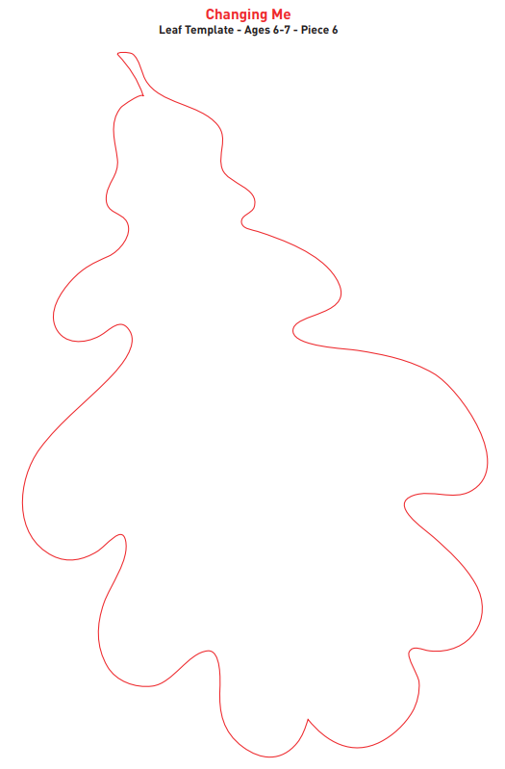
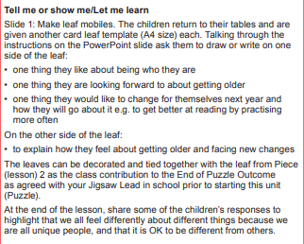
Piece 6 - Reflection

Slide 20
Can parents withdraw their children from RSE?
From September 2020…
(Government guidance 2019 page 17)
“Parents have the right to request that their child be withdrawn from some or all of sex education delivered as part of statutory RSE”.
NOT from Relationships or Health Education.
So, this session is to inform you of what this school defines as Sex Education,
what we intend to teach in RSHE and why…
…so you can make this decision.

Slide 21


Any questions?

Slide 22

Thank you!

